Slide 1
Heat Treating
CERAMIC- FOURTH CLASS
of Glasses and glasses
ceramic Annealing
When a ceramic material is cooled from
an elevated temperature, internal stresses, called thermal stresses, may be introduced as a result of the difference in cooling rate and thermal contraction between the surface and interior regions. These thermal stresses are important in brittle ceramics, especially glasses, since they may weaken the material or, in

Slide 2
extreme cases, lead to fracture, which is
CERAMIC- FOURTH CLASS
termed thermal shock. Normally,
attempts are made to avoid thermal stresses, which may be accomplished by cooling the piece at a sufficiently slow rate. Once such stresses have been introduced, however, elimination, or at least a reduction in their magnitude, is possible by an annealing heat treatment in which the glass is heated to the

Slide 3
annealing point, then slowly cooled to
CERAMIC- FOURTH CLASS
room temperature.
Glass Tempering
The strength of a glass piece may be
enhanced by intentionally inducing (generating) compressive residual surface stresses. This can be accomplished by a heat treatment procedure called thermal tempering. With this technique, the glassware is heated to a temperature below the

Slide 4
softening point. It is then cooled to room
CERAMIC- FOURTH CLASS
temperature in a stream of air or, in some
cases, an oil bath. The residual stresses arise from differences in cooling rates for surface and interior regions. Initially, the surface cools more rapidly and, once having dropped to a temperature below the strain point, becomes rigid. At this time, the internal parts of the glassware, having cooled less rapidly, is at a higher temperature (above the strain point) and,

Slide 5
therefore, is still plastic. With continued
CERAMIC- FOURTH CLASS
cooling, the interior attempts to contract
to a greater degree than the now rigid exterior will allow. Thus, the inside tends to draw in the outside, or to impose inward radial stresses. As a consequence, after the glass piece has cooled to room temperature, it stands compressive stresses on the surface, with tensile stresses at interior regions. The room- temperature stress distribution over a

Slide 6
cross section of a glass plate is
CERAMIC- FOURTH CLASS
represented schematically in Figure 2.
The failure of ceramic materials almost always results from a crack that is initiated at the surface by an applied tensile stress. To cause fracture of a tempered glass piece, the magnitude of an externally applied tensile stress must be great enough to first overcome the residual compressive surface stress and, in addition, to stress the surface in

Slide 7
tension sufficiently to initiate a crack,
CERAMIC- FOURTH CLASS
which may then propagate. For an
untempered glass, a crack will be introduced at a lower external stress level, and, consequently, the fracture strength will be smaller. Tempered glass is used for applications in which high strength is important; these include large doors and eyeglass lenses.

Slide 8

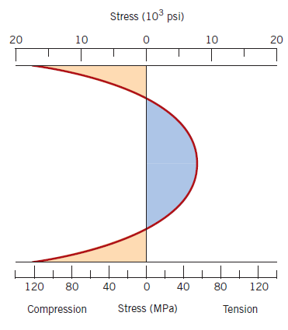
CERAMIC- FOURTH CLASS
Figure 2: Room-temperature residual stress distribution over the cross section of a tempered glass plate.

Slide 9
FABRICATION AND PROCESSING OF CLAY PRODUCTS
CERAMIC- FOURTH CLASS
This class of materials includes the
structural clay products and the whitewares. In addition to clay (being
composed of alumina (Al2O3) and silica (SiO2)), many of these products also contain other ingredients. After having been formed, pieces most often must be subjected to drying and firing operations; each of the ingredients influences the

Slide 10
changes that take place during these
CERAMIC- FOURTH CLASS
processes and the features of the
finished piece.
The as-mined raw materials usually have to go through a milling or grinding operation in which particle size is
reduced; this is followed by screening or sizing to produce a powdered product having a desired range of particle sizes. For multicomponent systems, powders must be thoroughly (totally) mixed with

Slide 11
water and perhaps other ingredients to
CERAMIC- FOURTH CLASS
give flow characteristics that are
compatible with the particular forming technique. The formed piece must have sufficient mechanical strength to remain intact during transporting, drying, and firing operations. Two common shaping techniques are utilized for forming clay- based compositions: hydroplastic forming and slip casting.

Slide 12
Hydroplastic Forming
CERAMIC- FOURTH CLASS
As mentioned above, clay minerals,
when mixed with water, become highly plastic and flexible and may be molded without cracking; however, they have extremely low yield strengths. The consistency (water–clay constant ratio) of the hydroplastic mass must give a yield strength sufficient to permit a formed ware to maintain its shape during handling and drying.

Slide 13
The most common hydroplastic forming
CERAMIC- FOURTH CLASS
technique is extrusion, in which a stiff
plastic ceramic mass is forced through a die cavity having the desired cross- sectional geometry; it is similar to the extrusion of metals. Brick, pipe, ceramic blocks, and tiles are all commonly fabricated using hydroplastic forming.
Slip Casting (solid and drain)
Another forming process used for clay-
based compositions is slip casting. A slip

Slide 14
is a suspension of clay and/or other
CERAMIC- FOURTH CLASS
nonplastic materials in water. When
poured into a porous mold, water from the slip is absorbed into the mold, leaving behind a solid layer on the mold wall the thickness of which depends on the time. This process may be continued until the entire mold cavity becomes solid (solid casting). Or it may be finished when the solid shell wall reaches the desired thickness, by inverting the mold and

Slide 15
pouring out the excess slip; this is termed
CERAMIC- FOURTH CLASS
drain casting. As the cast piece dries and
shrinks, it will release from the mold wall; at this time the mold may be disassembled (take to pieces) and the cast piece removed. The nature of the slip is extremely important; it must have a high specific gravity and yet be very fluid and pourable. These characteristics depend on the solid to water ratio and other agents that are added. An

Slide 16
acceptable casting rate is an essential
CERAMIC- FOURTH CLASS
requirement. In addition, the cast piece
must be free of bubbles, and it must have a low drying shrinkage and a relatively high strength.

Slide 17
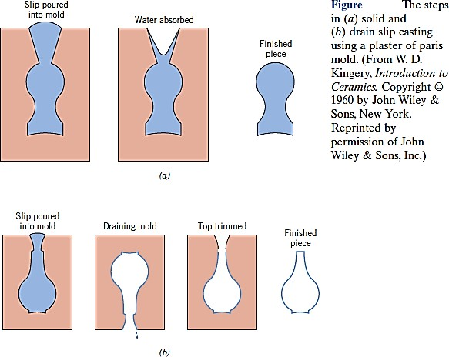
CERAMIC- FOURTH CLASS
The properties of the mold itself influence
the quality of the casting. Normally,
plaster of Paris, which is economical, relatively easy to fabricate into

Slide 18
complicated shapes is used as the mold
CERAMIC- FOURTH CLASS
material. Most molds are multipiece
items that must be assembled before casting. Also, the mold porosity may be diverse to control the casting rate. The relatively complex ceramic shapes that may be produced by means of slip casting include art objects, and specialized scientific laboratory ware such as ceramic tubes.

